Slide 1

Regression and Regression with Neural Networks
EPS 268
September 12 2019
Start of class assignment: 1) Run this in MATLAB> openExample('nnet/BodyFatEstimationExample’). 2) If that works compare it to linear least squares solution. 3) If that also works, quantitatively compare the two models (AIC?).

Slide 2
First, an example
> openExample('nnet/BodyFatEstimationExample')
But is a fancy NN any better than linear least squares?
HINT: The least squares estimator is defined as,
Where y is a vector whose ith element is the ith observation of the dependent variable, and X is a matrix whose ij element is the ith observation of the jth independent variable. Or you can just use built in MATLAB functions.

Slide 3
Regression analysis is a set of statistical processes for estimating the relationships among variables. (Wikipedia)
Regression. A class of techniques that seeks to make predictions about un-known continuous target variables given observed input variables. (Harvard CS 180)

Slide 4
Regression Techniques
K-Nearest-Neighbors (take average of the K nearest data points)
Neural networks (scale and combine data in a nonlinear fashion)
Random forest (ensemble of decision trees)
Gradient boosted decision trees (directed ensemble of decision trees)
Linear regression

Slide 5
Linear Regression
“Goal” is to find the best fitting linear model, with input data x, weights W, bias b, and prediction y.
“Best” is determined by minimizing the sum of square residuals,
This is also called a “loss function”, “objective function”, or “cost function”.
There is a close connection with the notion of optimization.
Wikipedia

Slide 6
Generalization: the ability of a model to perform well on new data points outside of the training set
(from Harvard CS 180 textbook)

Slide 7
Bias-Variance Tradeoff
When constructing machine learning models, we have a choice somewhere on a spectrum between two extremes: fitting exactly to our training data or not varying in response to our training data at all.
The first extreme, fitting all of our training data, is a situation of high variance, because our output changes heavily in response to our input data.
At the other extreme, a solution that doesn't change in response to our training data at all is a situation of high bias.
(from Harvard CS 180 textbook)

Slide 8
Neural Networks

Slide 9
Neural Networks and Regression
Linear regression attempts to estimate a function f(x).,
But data may warrant a nonlinear form for f(x)….
The simplest description of a neural network is a function f(x),
We would call this a two-layer network. A three-layer network might look like this:
The nonlinear function (here it’s the max function) is also called the activation function.

Slide 10
Neural Network Training, or How to estimate parameters
Higher error
The most common method for neural network parameter estimation is based on (some kind of) gradient descent.
Closed form, matrix algebra is possible for linear least squares, but not for nonlinear neural networks.
Lower error
Wikipedia

Slide 11
Neural Network Training, or How to estimate parameters
Backpropagation is the procedure by which we pass errors backwards through a feed-forward neural network in order to compute gradients for the weight parameters of the network. (Harvard CS 180)
Backpropagation essentially finds clever uses of the chain rule to explain the total error F in terms of the individual parameters of the model.

Slide 12
Cross Validation: prevent overfitting
A subsampling procedure used over a data set to tune hyperparameters and avoid over-fitting.
Training is first performed on ~80% of data. This is the training data set.
Weights are updated using backpropagation. The error is sometimes called the training loss.
The error is then evaluated on the 10%% of reserved data called the validation set and associated validation loss.
Once the training loss is much lower than the validation loss, it’s time to stop optimizing! One last test is done on the test data set (also ~10%), which has been unused up to now.
towardsdatascience.com

Slide 13
Training and Training rate
Source: Andrew Ng’s Machine Learning course on Coursera
Stanford CS 231
http://cs231n.github.io/neural-networks-1/

Slide 14
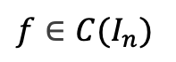
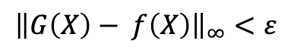
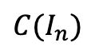
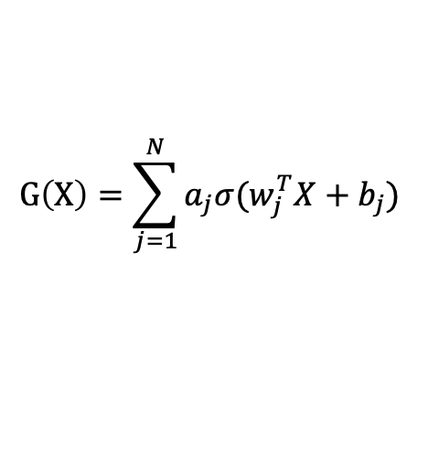
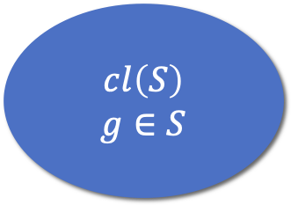
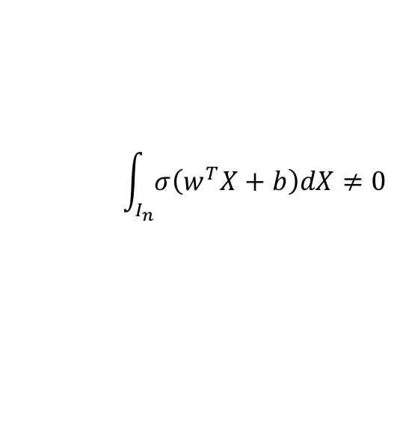
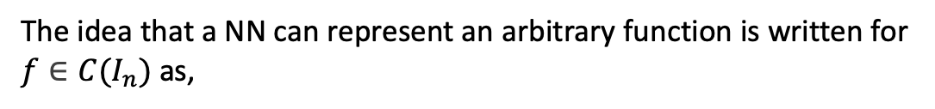
Universal Approximation Theorem
What follows is a simplification of slides from Yotam Amar and Heli Ben Hamu that probably erroneously neglects measure theoretic considerations.
Neural networks can be expressed as a function with the form
$$G\left(X\right)=\sum_{j=1}^{N}{a_{j}σ(w_{j}^{T}X+b_{j}) }$$
The idea that a NN can represent an arbitrary function is written for $f∈C(I_{n})$ as,
$C(I_{n})$
$f∈C(I_{n})$
$${\left\|G\left(X\right)− f\left(X\right)\right\|}_{∞}<ε$$
$$cl\left(S\right)$$
$$g∈S$$
The proof of this theorem begins by noting that the sigmoid function is discriminatory,
$$\int_{I_{n}}{σ\left(w^{T}X+b\right)dX}≠0$$
Are these two regions identical?

Slide 15
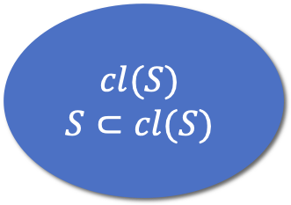
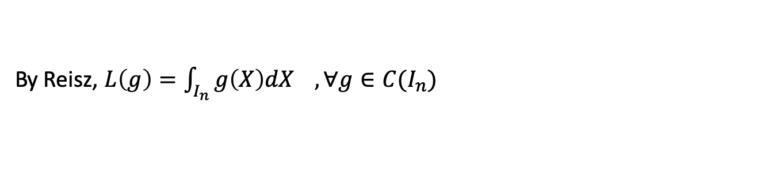
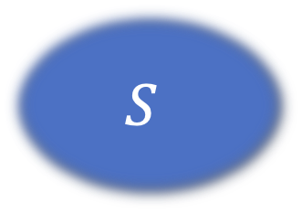
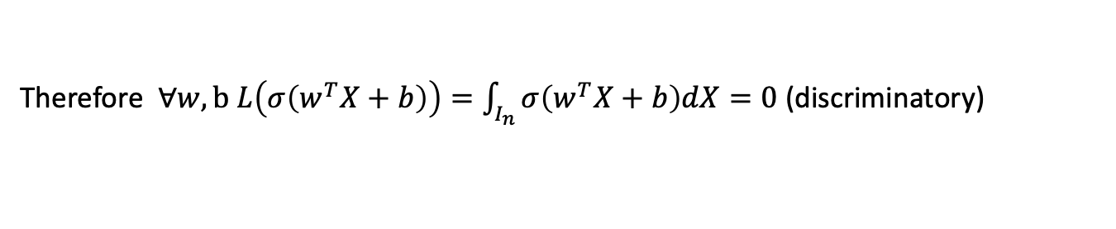

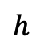
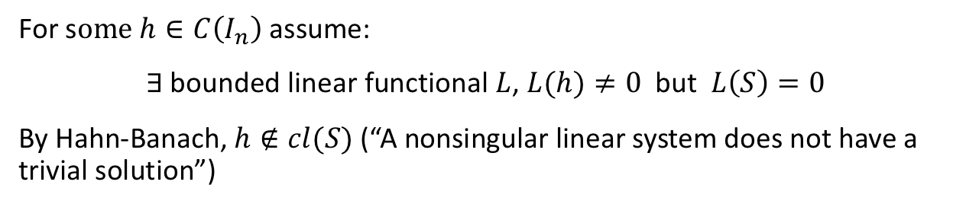
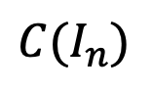
Universal Approximation Theorem
Let $S⊂C(I_{n})$ be the set of functions of the form $G(X)$. $S$ is linear.
For s$ome h∈C\left(I_{n}\right)$ assume:
$∃$bounded linear functional $L$, $L(h)≠0$ but $L\left(S\right)=0$
By Hahn-Banach, $h∉cl(S)$ (“A nonsingular linear system does not have a trivial solution”)
$$h$$
$$C(I_{n})$$
$$S$$
By Reisz, $L\left(g\right)=\int_{I_{n}}^{ }{g\left(X\right)dX} ,∀g∈C(I_{n})$
$$cl(S)$$
$$S⊂cl(S)$$
In particular $∀w∈ℝ^{n},b∈ℝ$ : $σ\left(w^{T}X+b\right)∈S$
Therefore $∀w,b L\left(σ\left(w^{T}X+b\right)\right)=\int_{I_{n}}^{ }{σ\left(w^{T}X+b\right)dX=0}$ (discriminatory)
This contradicts $L\left(h\right)≠0$! The point h therefore cannot exist and the two sets are identical.

Slide 16
Examples

Slide 17

Example 1: Estimating Glacier Thickness
How much glacier ice is there on Earth?
We have ~ 3mil in situ thickness measurements from about 5k glaciers.
We have outlines for ~1mil glaciers around the world but most have no thickness info.
Can we use the notion that glaciers have common shapes to estimate thickness for the majority of glaciers without in situ measurements?

Slide 18
Example 2: Ice sheet model emulation
Glaciers and Ice Sheets flow down hill because of gravity.
Models generally solve for the time-evolution of the ice thickness, H,
Simulating the physics of this flow can be very computationally demanding.
Can f be approximated using a NN?

